Slide 1
AgrAbility AT in a Box for Farmers and Ranchers
Karen Funkenbusch
University of Missouri
National AgrAbility Training Workshop
March 31st – April 3rd, 2014
Lexington, Kentucky

Slide 2
Cultivating AT solutions for farmers and ranchers with disabilities
Discuss Points:
1. Health conditions, disabilities, and age-related changes experienced by our clients.
2. Who are our “new” client.
3. “New” and “emerging” assistive technologies (AT).
4. Working with clients to help assess assistive technology solutions.
5. Review how an ergonomic onsite farmstead assessment and AT in a Box help farmers, ranchers, and farmworkers perform a task they thought otherwise not possible.

Slide 3
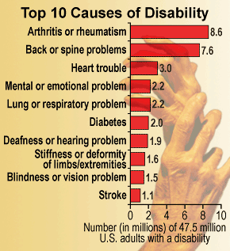
Discussion Point: 1
According to the CDC…
Nationally, Leading Causes of Disability by the Numbers

Slide 4
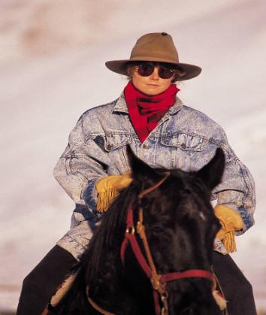
Leading Causes of Disability
In Missouri, most commonly reported conditions that cause farmers, ranchers, and farmworkers to miss work have included:
Arthritis
Back pain
Heart Disease
Cancer
Depression
Diabetes

Slide 5
Common Conditions That Causes Disabilities
Arthritis and other musculoskeletal problems.
These are the most common causes of long-term disability. They make up as much as a third of all disability cases.
About 1 and 3 people say arthritis affects their ability to do their jobs, according to the CDC.
Other muscle and joint problems – bad backs, bones that never mend, bad hips – are very common causes of disability too.

Slide 6
Common Conditions That Causes Disabilities
Heart disease.
Can severely limit their ability to work.
Studies estimate that heart disease is now the reason for 17% of all health costs in the U.S.

Slide 7
Common Conditions That Causes Disabilities
Cancer. While cancer itself can be disabling, treatments such as surgery, radiation, and chemotherapy coupled with physical and mental stress can also make it difficult to work.
With better techniques for early diagnoses and more effective treatments “people are living much longer after a cancer diagnosis than they once did.”

Slide 8
Common Conditions That Causes Disabilities
Mental health problems. You might think of disability as physical, but mental health problems can make work difficult or impossible.
Depression, bipolar disorder, post traumatic shock syndrome, and other conditions can be as disabling as any physical illness.

Slide 9
Common Conditions That Causes Disabilities
Diabetes.
Along with obesity, it's linked to a number of serious health problems, like heart disease.
Diabetes is a costly disease to manage, too, in part because of the drugs and supplies.

Slide 10
Common Conditions That Causes Disabilities
Age Related Changes.
Brain - memory
Bones and joints - The weight-bearing bones and the movable joints take much wear and tear as the body ages. The most common age-related conditions are: osteoporosis and arthritis.
Eyes and ears - About the age of 40, eyesight weakens, and at around 60, cataracts and macular degeneration may develop. Hearing also declines with age.
Functional abilities - Falls become an increasingly common reason for injuries. Falls can come as a result of other changes in the body: Sight, hearing, muscle strength, coordination, and reflexes aren't what they once were. Balance can be affected by diabetes and heart disease, or by problems with your circulation or nervous system. Some medicines can cause dizziness.

Slide 11
Discussion Point: 2
Who are our “new” clients:
Clients post 5 years of receiving initial AgrAbility services (assistive technology or adapted devices)
College and high school students (male, head injury, autism, getting ready to graduate, family looking for potential employment opportunities)
Baby Boomers (retired, hobby farmers, couples)
Veterans (male, female, couples – recently returning from war)
Older (female)
Large operators (1,500 plus acres, middle age, stroke, veteran) = AT in the Box

Slide 12
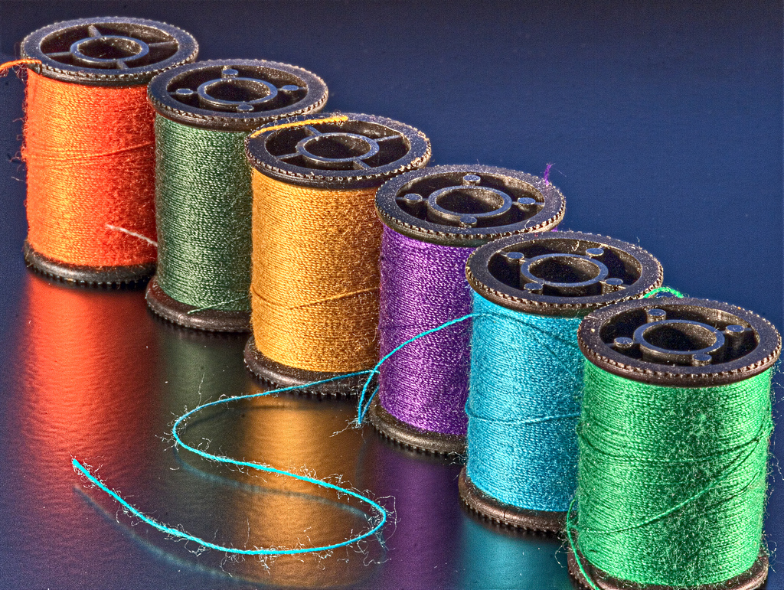

Slide 13
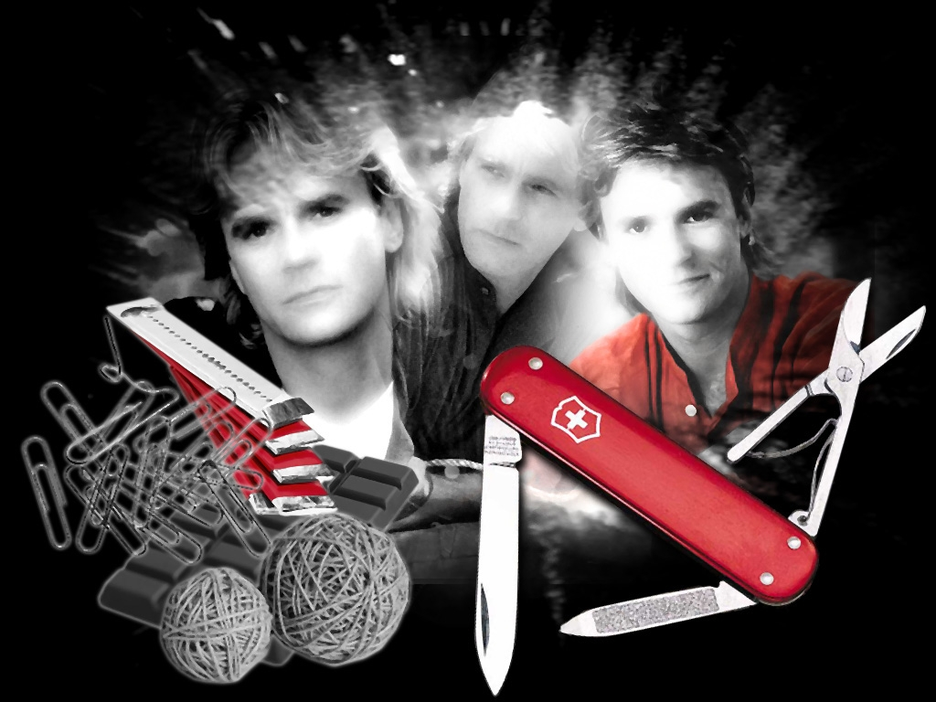
Discussion Point: 3
Wanting “new” and “emerging” assistive technologies (AT)… early adopters of technology, innovative, different view of agriculture.

Slide 14
Discussion Point 4
AT
AT in a Box help individuals perform an essential farm or ranch task they thought otherwise not possible and decreased risk of acquiring secondary injury.

Slide 15
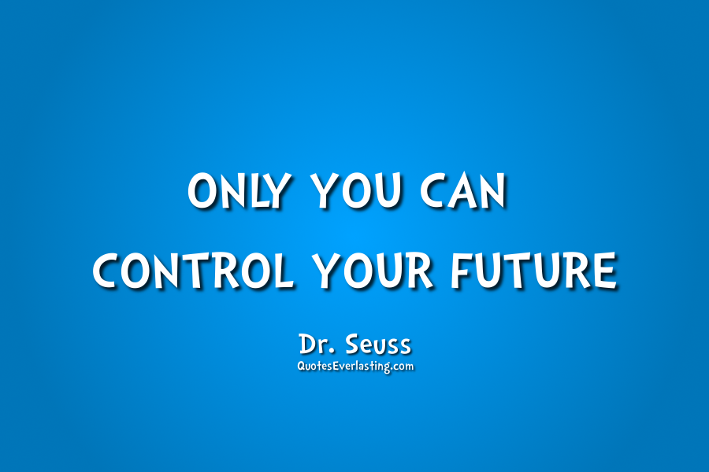
Assistance
Provide consultation and technical assistance to farmers, ranchers, farmworkers and their family members to increase their likelihood of remaining in production agriculture
Notes:
Key Points:
Briefly describe
information and referral,
outreach to educate agriculture workers about farming with a disability,
onsite technical assistance and advocacy.
Specific information about what your project does will be offered later in the curriculum.
Suggested Learning Activities:
Use a video clip to show working with a farmer. USDA “Its AgrAbility “ videos are available at http://www.csrees.usda.gov/newsroom/partners/partners_11.html

Slide 16
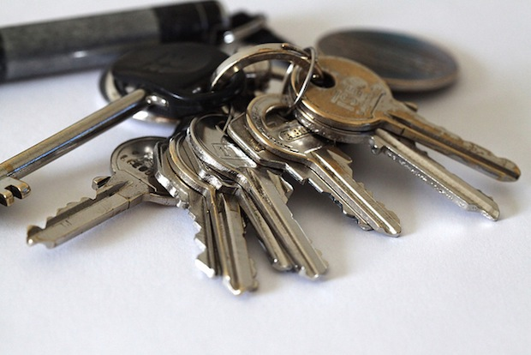
Ergonomic Onsite Farmstead Assessment
Assist clients in determining assistive technology solutions that are ergonomically appropriate -- fitting a job to a person based on their operation, function, and satisfaction.
Provide support that best matches their needs and priorities; something that doesn’t interfere too much with their daily routine, and helps to function, confidence, and overall better quality of life.
Successful integration of an appropriate assistive technology solution in a box can help client perform their essential job functions and decrease their risk of acquiring secondary injuries.

Slide 17
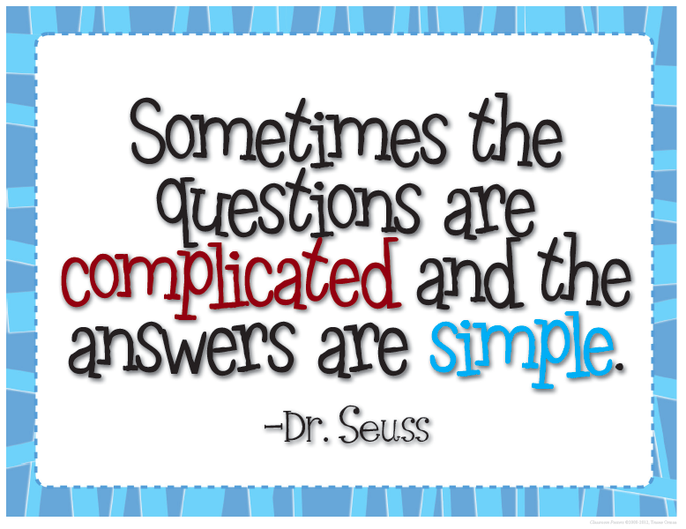
Discussion Point 5
AT
AT in a Box is all about client choice. It helps our farmer, rancher, or farmworker perform a task they thought otherwise not possible.

Slide 18
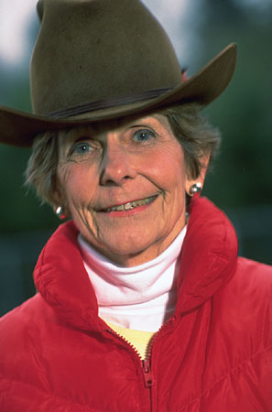
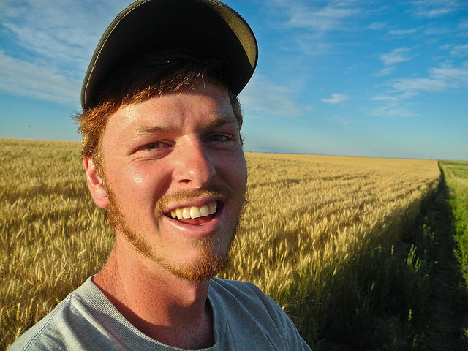
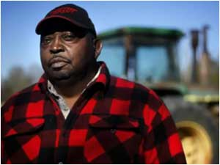
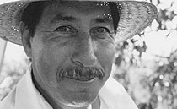
AgrAbility clients face employment challenges and potential income loss if they are not able to work due to a physical change from illness, accident, or general age-related change.

Slide 19
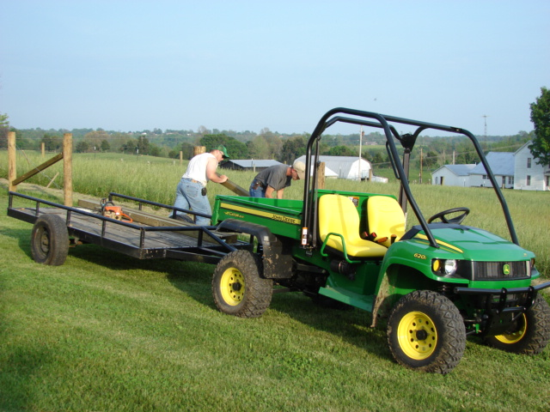
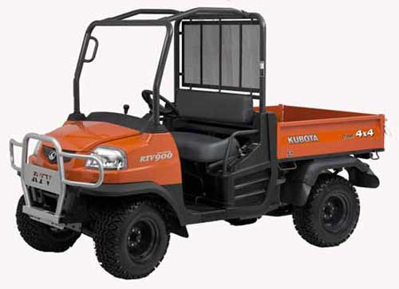
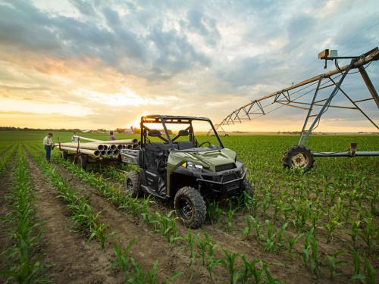

Slide 20
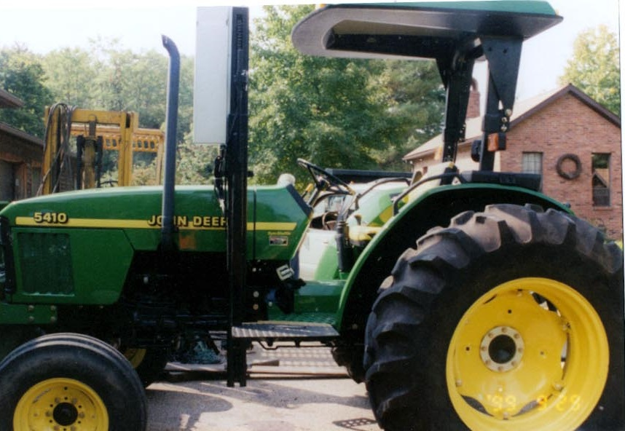
Assistive Technology
Life Essential Standing Platform Pilot Lift

Slide 21
Lift Attached to Flatbed Truck for Transfer Between Machines

Slide 22
Flatbed Truck with Braun UVLTM to Access Truck & Life EssentialsTM Attached Lift to Access Farm Equipment

Slide 23
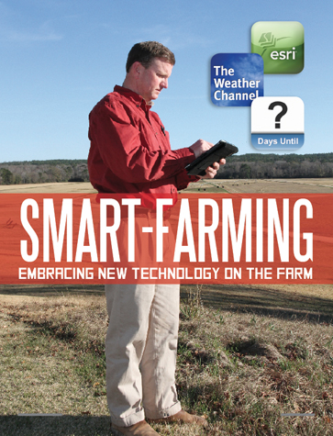
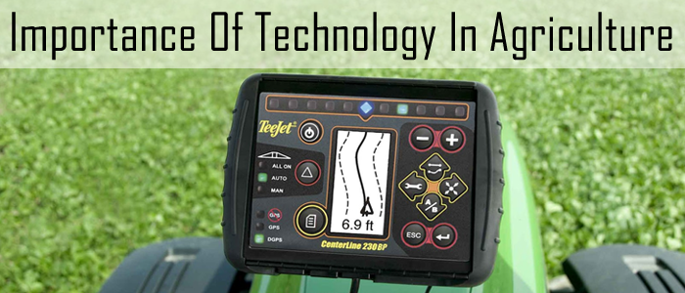
OH, THE THINGS THEY CAN DO!

Slide 24
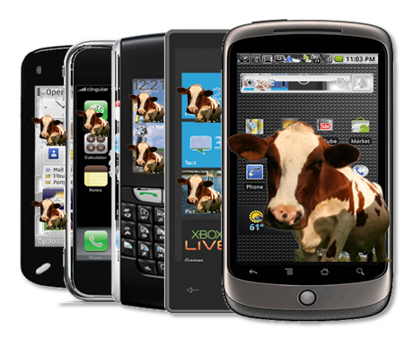
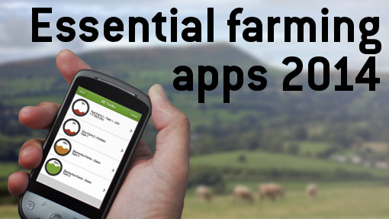
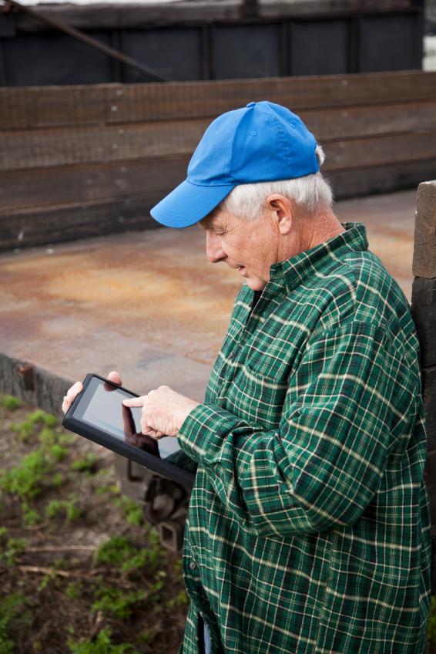
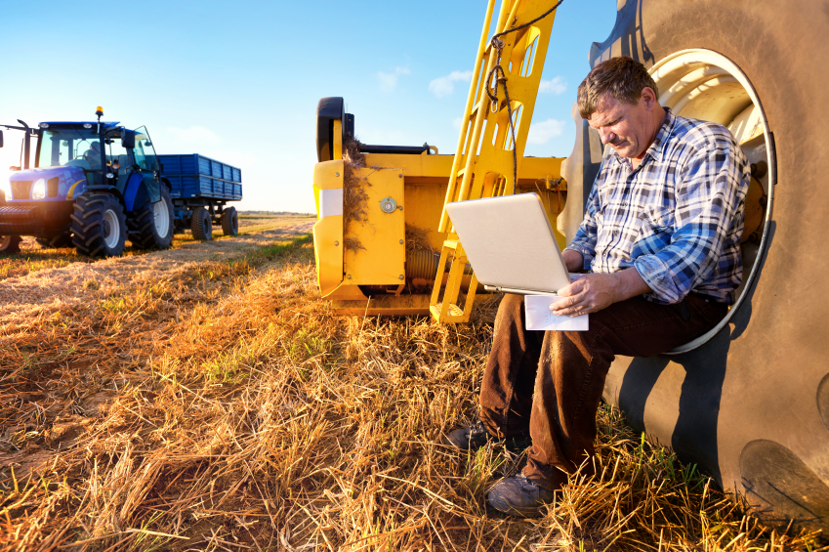
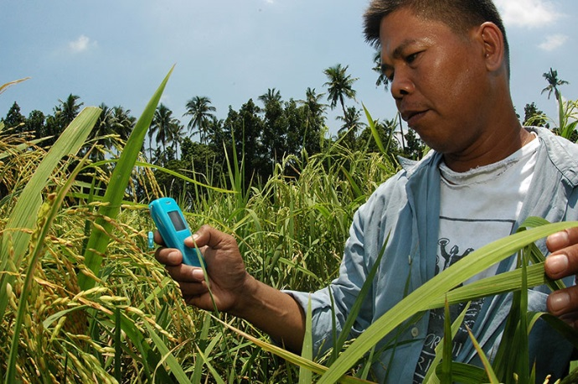

Slide 25
Nearly half of American farmers are using a smartphone
With a few touches on the iPad, a farmer can turn on the fans remotely
Some farmers are dismissive about needing or wanting to adopt the new technology (client choice… but, it is our future)
Need to stay up-to-date and relevant with new and emerging technology
More U.S. farmers and ranchers are using smart phones or other mobile devices to increase efficiency and generate higher profits.

Slide 26
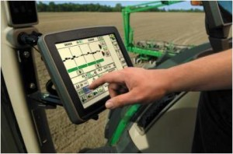
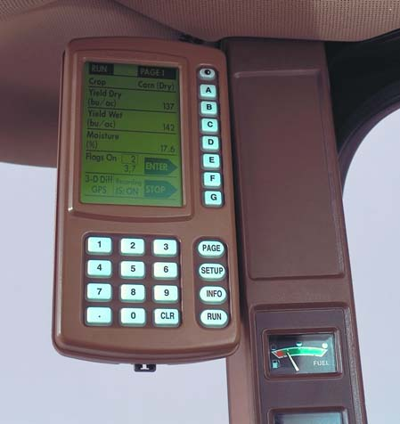
John Deere Auto Trac
Hands-Free assisted steering system
GPS autosteer technology.
Producers are constantly looking to improve productivity in the field with less stress and fatigue on the operator, and these challenges are driving an increase in adoption of technologies, with automated guidance providing an entry level solution.

Slide 27
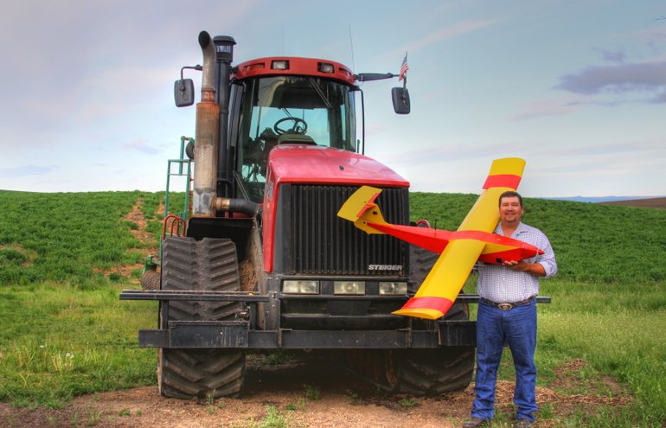
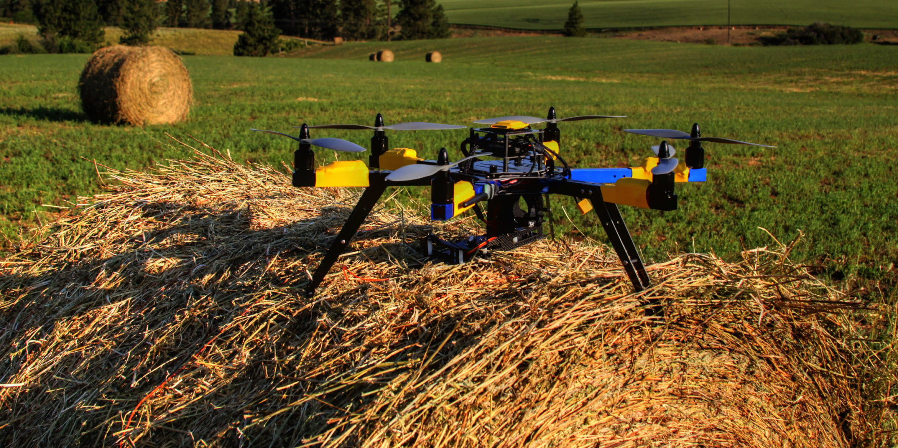
Drones
An unmanned aerial vehicle, also known as a drone, is an aircraft without a human pilot on board. Its flight is controlled either by computers in the vehicle or under the remote control of a pilot on the ground or in another vehicle.
Farmer holding an unmanned aircraft that he built. This home-made drone equipped with up to four cameras to “scout” his 1,500 acres of wheat and cow pasture.

Slide 28
Drones For Agricultural Crop Surveillance
Using drones for crop surveillance can drastically increase farm crop yields while minimizing the cost of walking the fields or airplane fly-over filming. Using Precision Vision™ Crop Health Imaging system, you can view composite video showing the health of your crops.
The Benefits of Drones in Farming
Increase Yields
Find potentially yield limiting problems in a timely fashion.
Save Time
While all farmers know the value of scouting their crops few actually have time to cover the acres on foot.
Return on Investment
Ease of use
Integrated GIS mapping
Crop Health Imaging
Failsafe - The Drone Flies Home

Slide 29
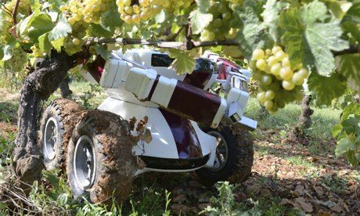
Robot farmers “farmbots” are the future of agriculture.
A robot used in vineyards and corn fields.
Benefits: an end to some of the most back- breaking jobs around the farm.
“Farmbots” are being developed and capable of finicky and complex tasks that have not been possible with the large-scale agricultural machinery of the past.
“wine bot” trundles through vineyards pruning vines.
“lettuce bot” is capable of hoeing away ground weeds from around the base of plants.
Other “bots” are under development to remotely check crops for their growth, moisture, and signs of disease.

Slide 31
Successful Outcomes for AgrAbility Clients
Increased ability to perform current or new work task(s) client thought otherwise not possible
Decreased potential for acquiring a secondary injury
Increased independence at work
Increased potential to secure support from funding agencies such as Rehab Services from the Blind, Vocational Rehab for Veterans, Vocational Rehab, and Insurance
Notes:
The successful outcomes of clients which the AgrAbility in Missouri Program has assisted include:

Slide 32
Contact
Karen Funkenbusch
University of Missouri Extension
232 Agricultural Engineering Building
Columbia, Mo 65203
1.800.995.8503
funkenbuschk@Missouri.edu

